Slide 1

CSI 120 Week 10
Lecture Notes

Slide 2
"There is an easy way and a hard way. The hard part is finding the easy way."
- Dr. Lloyd

Slide 3
Intro to Arrays
An ARRAY is a collection of variables
An ARRAY allows you to store a group of items of the same data type together in memory
Doing calculations on a collection of numbers is easier than having multiple variables of that type
This is because each variable can only hold one number:
int grade1 = 88;
int grade2 = 92;
Variables are not ideal for storing and processing lists of data. Instead of having multiple grade variables it would be easier to have one grades Array

Slide 4
Why use Arrays?
Lets assume we need to store a collection of integers to represent student grades.
If I created int variables for them each variable can only store one grade
int grade1 = 88;
int grade2 = 92;
Individual variables are not ideal for storing and processing lists or collections of data. Instead of having multiple grade variables it would be easier to have one grades Array

Slide 5
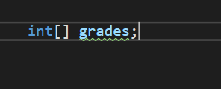
Arrays Continued
To create an ARRAY, we must first decide what type of data the array will hold.
It is possible to create an ARRAY of int, doubles, strings, etc.… Any data type we have worked with so far can be made into an array.
In C#, the generic format to declare a variable for an array is:
DataType[] arrayName;
Declaring an array of integers named grades

Slide 6

Arrays Size
Before the array can be used a SIZE must be given to it. How many values will be stored in the array.
This is done using the NEW keyword
DataType[] arrayName = new DataType[SIZE];
Initializing an array of integers named grades with a size of 10

Slide 7
Array Examples
Creating an array of integers that can hold 10 integer values
int[] numbers = new int[10];
Creating an array of doubles that can hold 6 double values
double[] grades = new double[6];
It is also possible to create an array with a list of VALUES
int[] numbers = {2, 5, 10, 4};
This will create he following array
2 | 5 | 10 | 4

Slide 8
Index vs Element
The INDEX is the location of a given value in an array.
The first value in the array is stored at index 0
The ELEMENT is the term for the value itself.
Consider the following example
int[] numbers = {15, 12, 4, 25, 10, 6};
What element is at index 3?
What is the index(location) of the element 4?
The elements of the array
15 | 12 | 4 | 25 | 10 | 6
The indices or location of the elements
0 | 1 | 2 | 3 | 4 | 5

Slide 9
Accessing the Elements
To access a given element by index the syntax is as follows:
nameOfArray[index]
Let’s assume the array below is called numbers
int x = numbers[4];
The value of x would be 10
int y = numbers[0];
The value of y would be 15
Console.WriteLine(numbers[5]);
6 would be print on the console.
15 | 12 | 4 | 25 | 10 | 6
0 | 1 | 2 | 3 | 4 | 5

Slide 10
Changing a value in an array
To access a given element by index the syntax is as follows:
nameOfArray[index]
Let’s assume the array below is called numbers
numbers[4] = 30;
This would change the element at index 4 to 25
numbers[1] = 7;
This would change the element at index 1 to 7
15 | 7 | 4 | 25 | 30 | 6
0 | 1 | 2 | 3 | 4 | 5

Slide 11
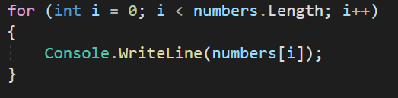
For Loop is an array’s best friend
A very common way to access each element of an array is using a for loop.
The default i variable in the for-loop syntax is named i because it refers to the index of an array
Arrays have a property called Length (SIZE) that can be used as the upper bound of the loop
Let’s assume the array below is called numbers
For loop that will print each element to the console
15 | 12 | 4 | 25 | 10 | 6
0 | 1 | 2 | 3 | 4 | 5

Slide 12
i is the INDEX. array[i] is the ELEMENT
When looping through an array it is important to remember the difference between the INDEX and the ELEMENT
i is the INDEX (location) of the ELEMENT
nameOfArray[i] is the ELEMENT
The elements of the array. While inside a for loop these are accessed with nameOfArray[i].
15 | 12 | 4 | 25 | 10 | 6
The indices or location of the elements. While inside of a for loop these will be represented by i.
0 | 1 | 2 | 3 | 4 | 5

Slide 13
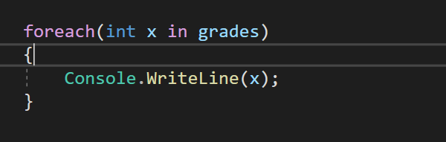
ForEach Loop
An alternative to a for loop when working with arrays is a foreach loop
A foreach loop is READ ONLY. Values in the array cannot be changed
A foreach loop has no i variable to track location, so it cannot be used to find the index of an element.
Printing out each element in grades using a foreach

